Slide 1

XYZ CORPORATION LENDING DATA-PROJECT
NAME : Shankarinarayani R
COURSE AND BATCH : Data Analytics & (2021-7001)

Slide 2
PROBLEM STATEMENT:
In this project have to manage credit risk by using the past data and deciding whom to give the loan to in the future. The text files contain complete loan data for all loans issued by XYZ Corp. through 2007-2015. The data contains the indicator of default, payment information, credit history, etc.
You will have use the training data to build models/analytical solution and finally apply it to test data to measure the performance and robustness of the models.

Slide 3
STEPS INVOLVED IN MODEL BUILDING
IMPORT PACKAGES
DATA PREPROCESSING
CHOOSING ML ALGORITHM TO WORK ON
PREDICTING RESULT
VISUALIZATION

Slide 4
DATA PREPROCESSING
Missing Value treatment.
Dropping irrelevant columns (unique id, categorical column with more levels/categories).
Dropping highly correlated columns (to reduce the risk of errors)
Treating outliers (For better performance).
Class imbalance treatment (reduce difference between class on target variable).

Slide 5
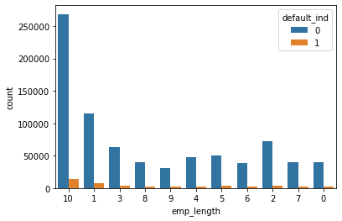
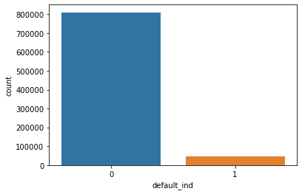
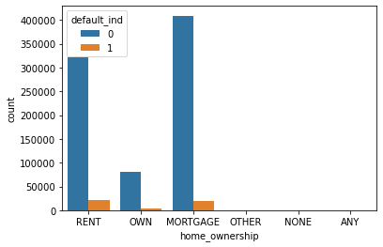
EXPLORATORY DATA ANALYSIS

Slide 6
CHOOSING ML ALGORITHM FOR DATASET
If Target Variable is Numerical/continuous data we have to go with linear regression
If Target Variable is categorical data we have to go with classification algorithm.

Slide 7
FITTING PROCESS
X_TRAIN
TRAIN DATA
X_TEST
SPLITTING DATA
Y_TRAIN
TEST DATA
Y_TEST

Slide 8
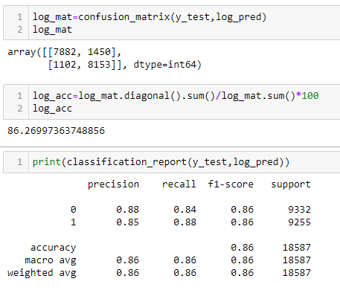
PREDICTING RESULT
Using regressing method predicting the result.
Predicting accuracy with the help of confusion matrix.(TP,FP,FN,TN)
Observe figure 1.

Slide 9
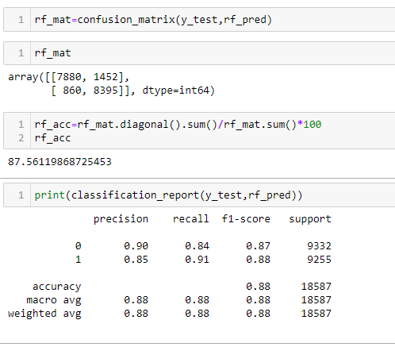
PREDICTING RESULT USING RANDOMFOREST
Random forest is also one of the technique comes under Classification algorithm used to predict the result.
Why RF?
Observe figure 2.

Slide 10
EVALUATION APPROACH
TECHNIQUES | ACCURACY
LOGISTIC REGRESSION | 86.00%
RANDOM FOREST | 87.42%
XG-BOOST | 87.67%

Slide 11
CONCLUSION
I Conclude that result of Random Forest Classifier is quiet good.
Prediction of positive case is high and its accuracy also quite better.
FUTURE SCOPE
Helpful to the company to predict the defaulter earlier and also which may allow company to choose whether to grant loan or not.

Slide 12
DISADVANTAGES OF RANDOM FOREST
Large no .of .Trees can make the algorithm too slow.

